Slide 1
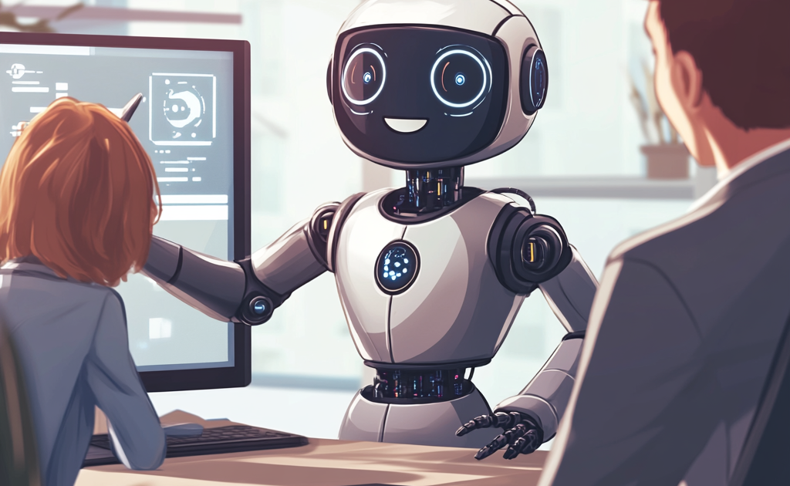
Building AI Agents
18.11.2024
RAG and tool calling
Hassan Al-Ubeidi

Slide 2
Agenda
1.
What is an agent?
2.
What is RAG?
3.
What is tool calling?
4.
How do I return structured responses?

Slide 3
Agenda
1.
What is an agent?
2.
What is RAG?
3.
What is tool calling?
4.
How do I return structured responses?

Slide 4
What is an agent
“AI agents are designed to perform certain tasks, answer questions, and automate processes for users.”
“They range from simple chatbots, to copilots to AI assistants”
Microsoft Learn
https://learn.microsoft.com/en-us/azure/cosmos-db/ai-agents

Slide 5

Perplexity AI
What is an agent: case study
A great example of an agentic application. Gives LLMs the ability to search the web to synthesize relevant search results

Slide 6
Agenda
Science Presentation
1.
What is an agent?
2.
What is RAG?
3.
What is tool calling?
4.
How do I return structured responses?
5.
Building a Perplexity clone

Slide 7
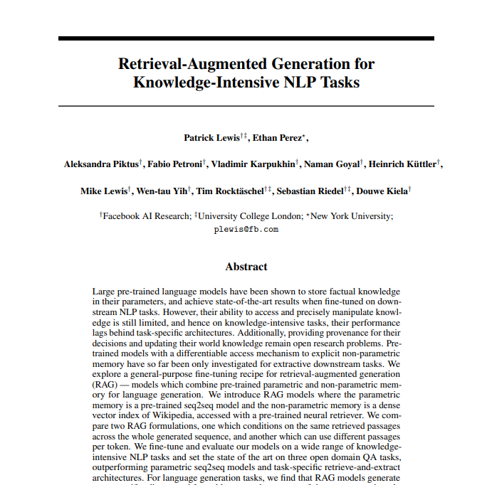
Retrieval Augmented
Generation
What is RAG? - Paper

Slide 8
Why use RAG? Why not just put everything in our context?

Slide 9

RAG - Patrick Lewis

Slide 10
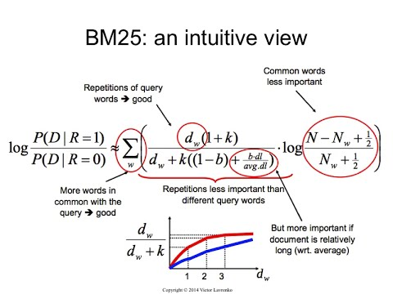
BM25
Science Presentation

Slide 11
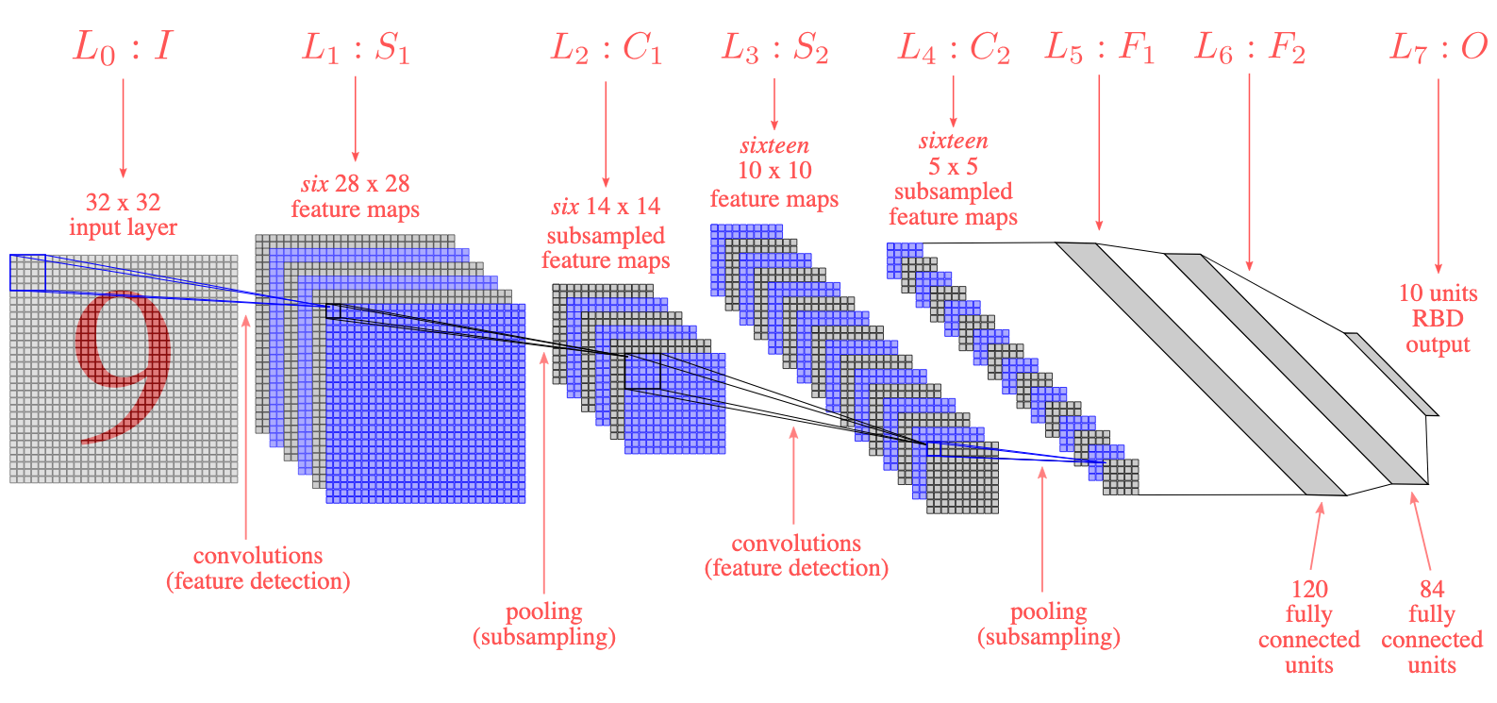
Information compression in Neural Networks
Science Presentation

Slide 12
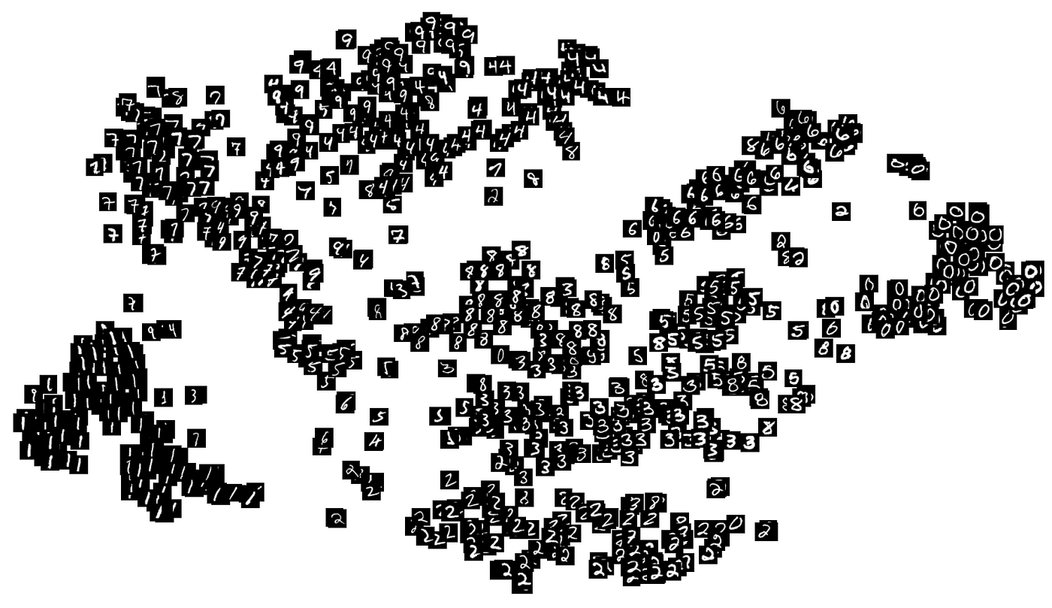
Latent space - MNIST
Ekin Tiu - Towards Data Science

Slide 13
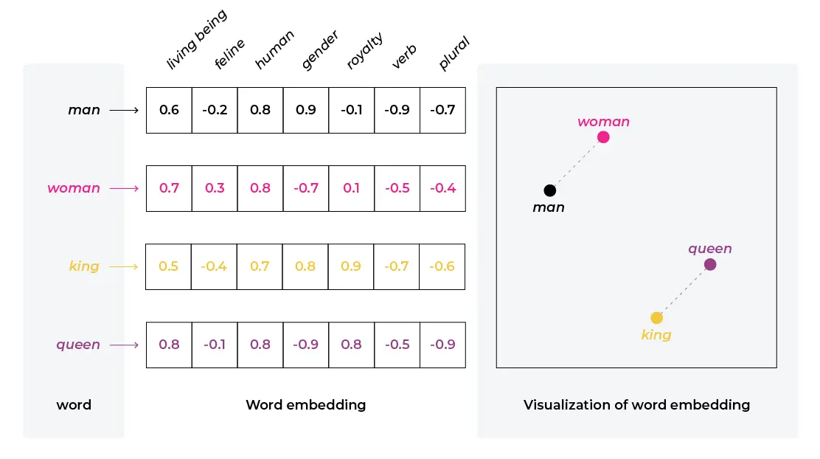
Latent space
Ekin Tiu - Towards Data Science

Slide 14
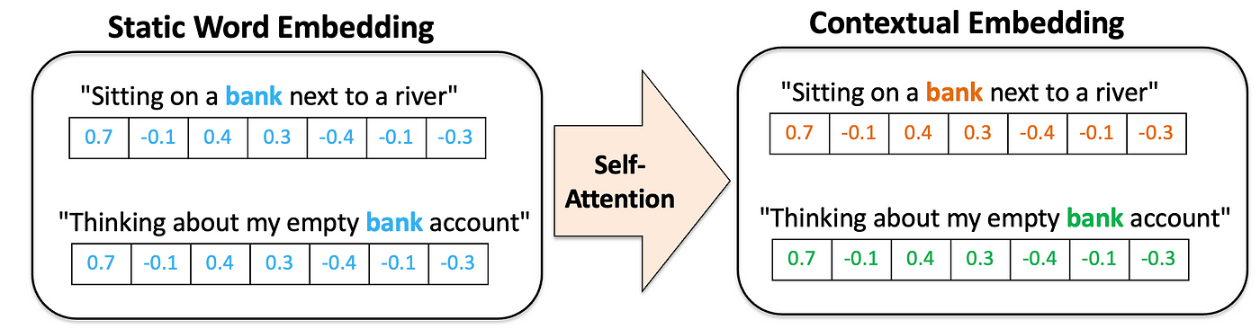
Latent space - BERT embeddings

Slide 15
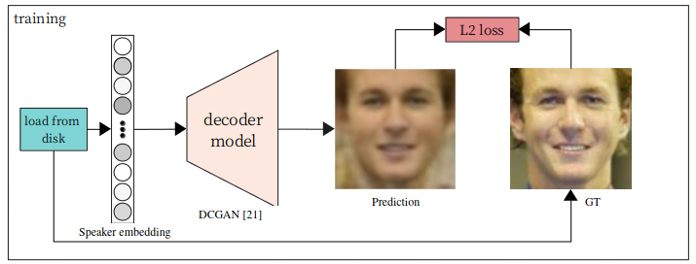
Latent space - BERT embeddings

Slide 16
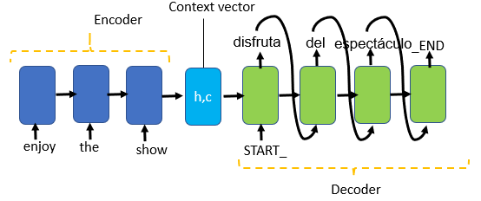
Latent space - BERT embeddings

Slide 17
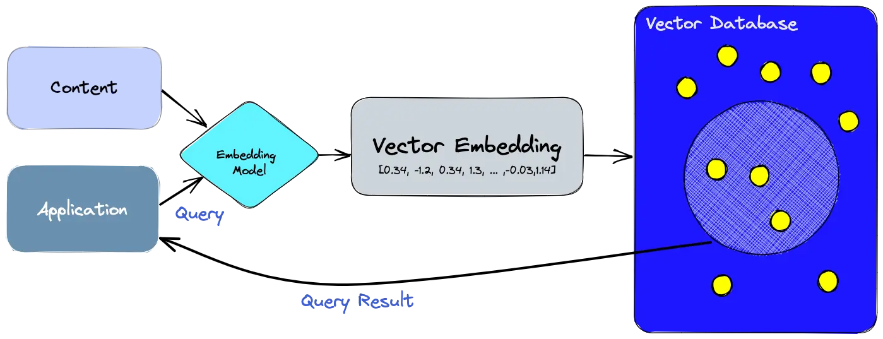
Storing embeddings
Science Presentation

Slide 18
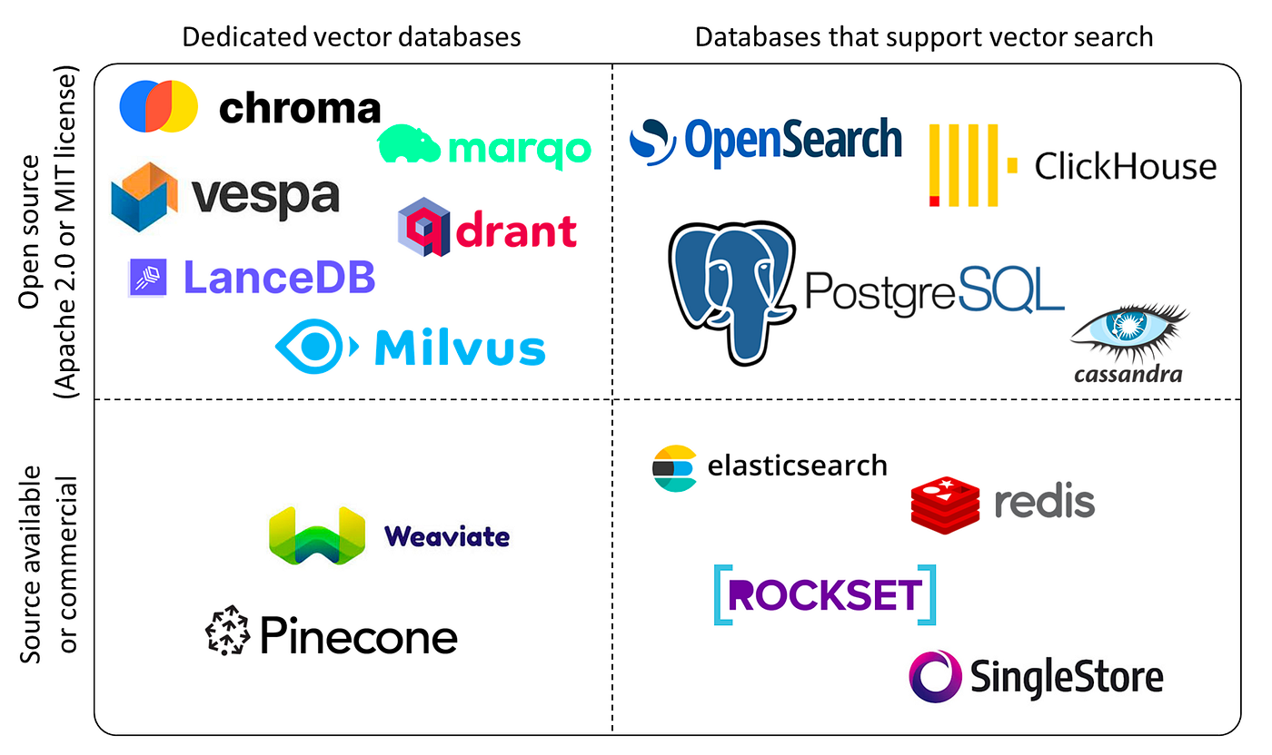
Vector database offerings
Science Presentation

Slide 19
DEMO

Slide 20
Agenda
1.
What is an agent?
2.
What is RAG?
3.
What is tool/ function calling?
4.
How do I return structured responses?
5.
Building a Perplexity clone

Slide 21
Defining the Problem
Function calling allows you to connect models like GPT-4o to external tools and systems.
OpenAI documentation
https://platform.openai.com/docs/guides/function-calling

Slide 22
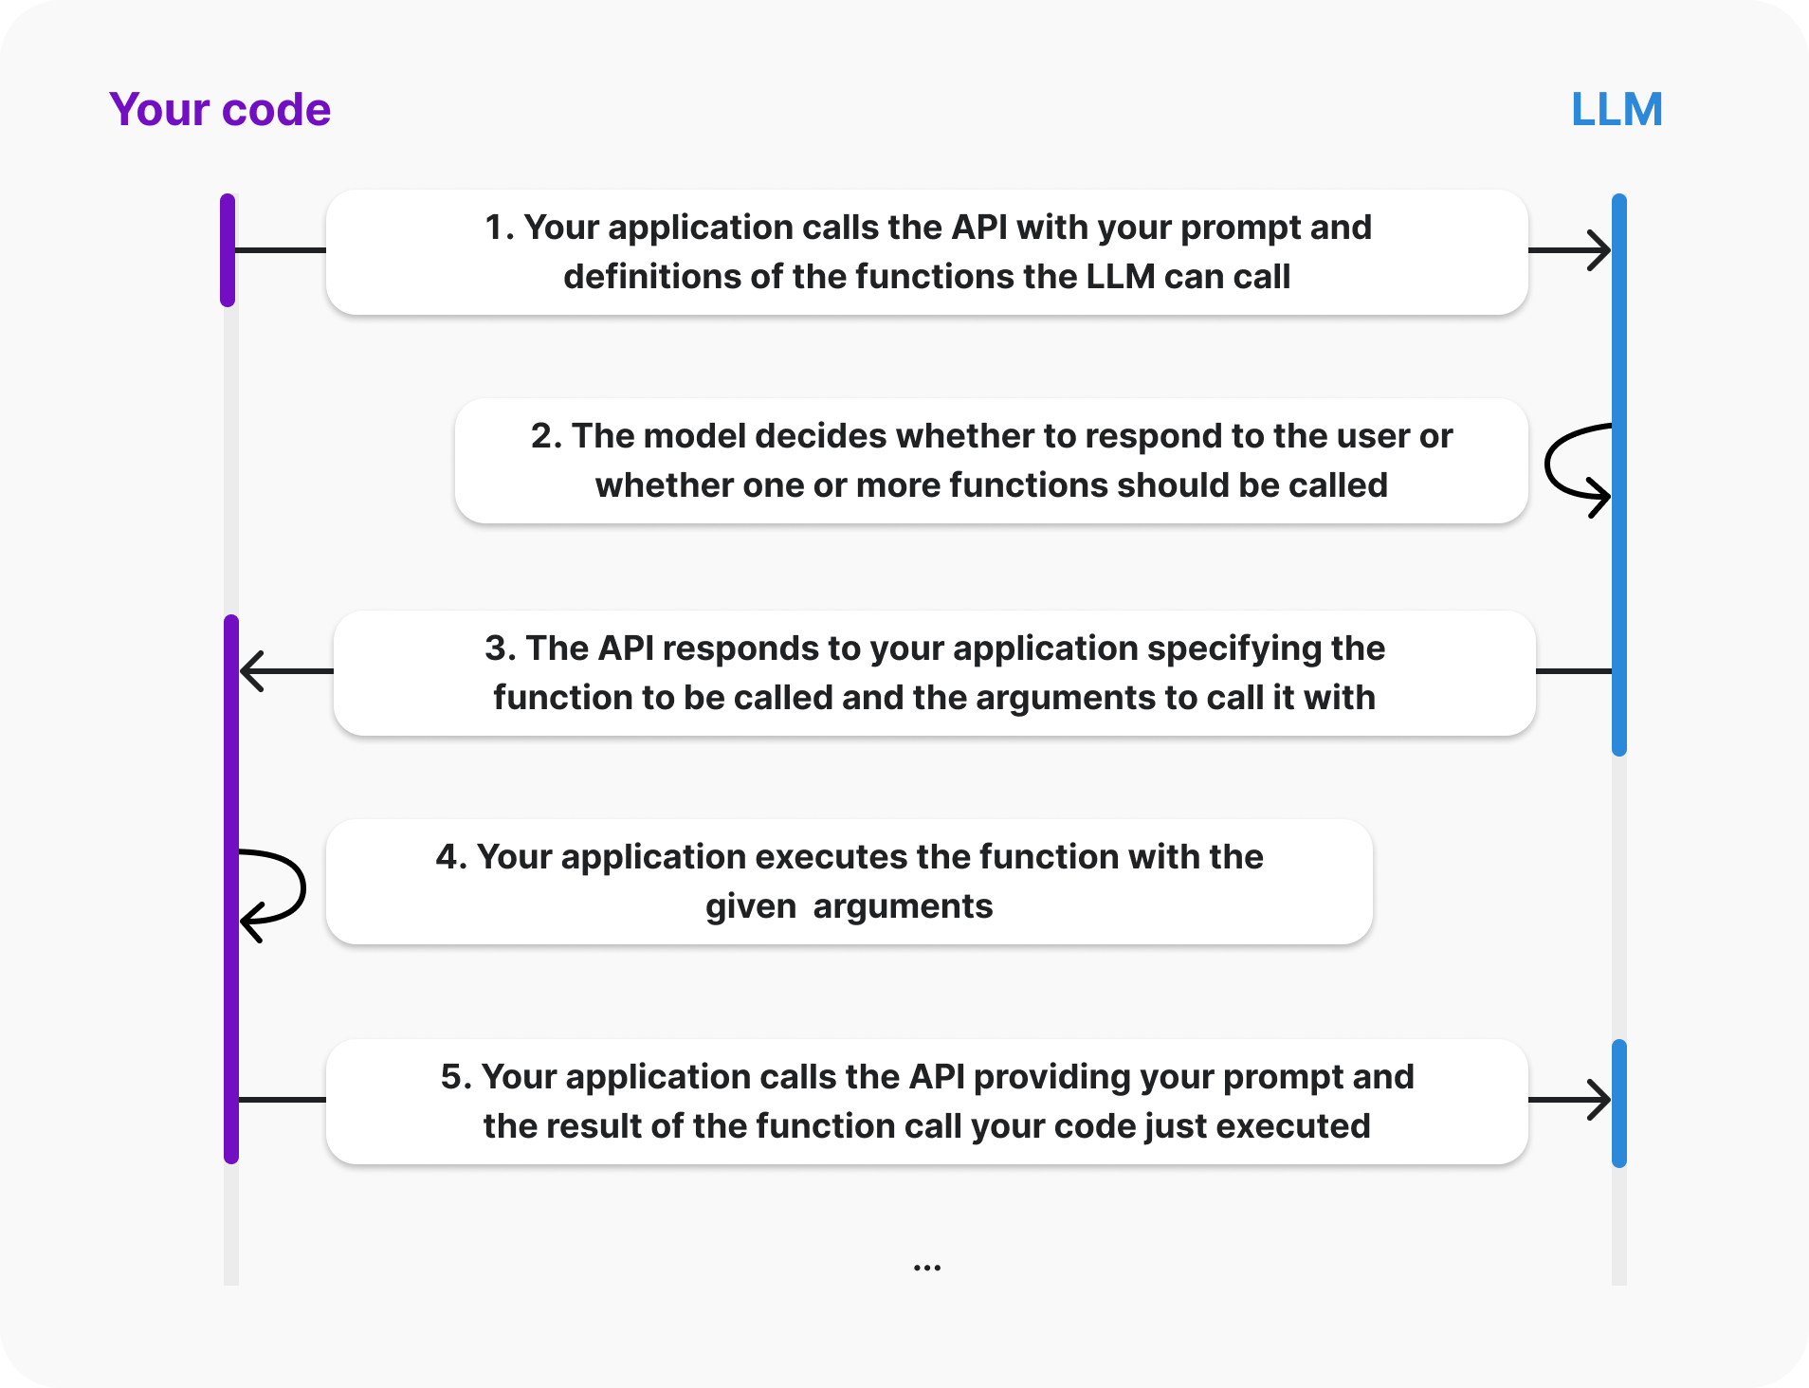
Tool calling flow

Slide 23
DEMO

Slide 24
Agenda
1.
What is an agent?
2.
What is RAG?
3.
What is tool/ function calling?
4.
How do I return structured responses?

Slide 25
What are structured outputs?
Science Presentation
Ensure responses follow JSON Schema for Structured Outputs
OpenAI documentation
https://platform.openai.com/docs/guides/structured-outputs

Slide 26
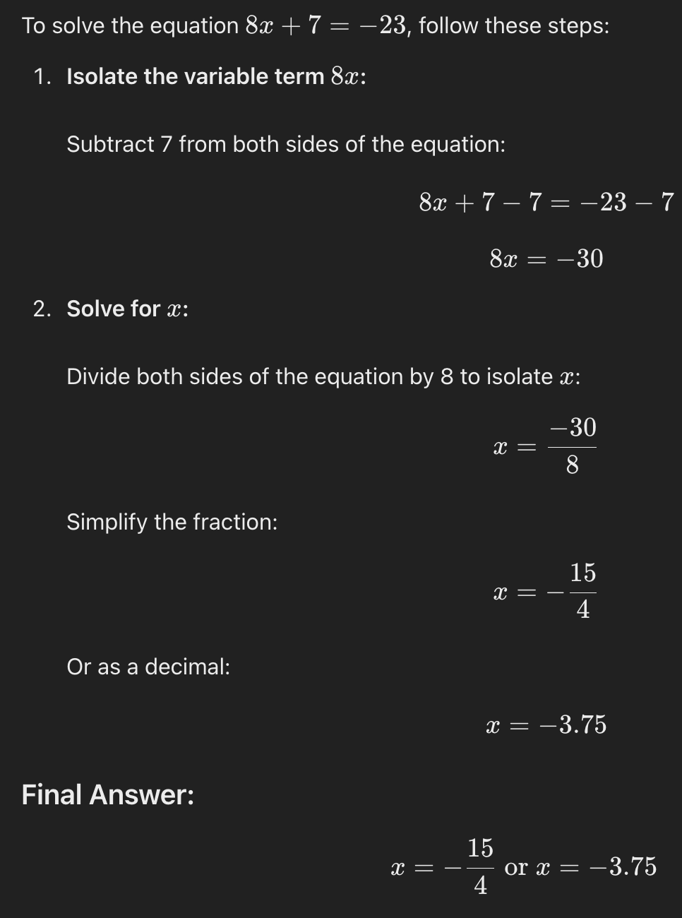
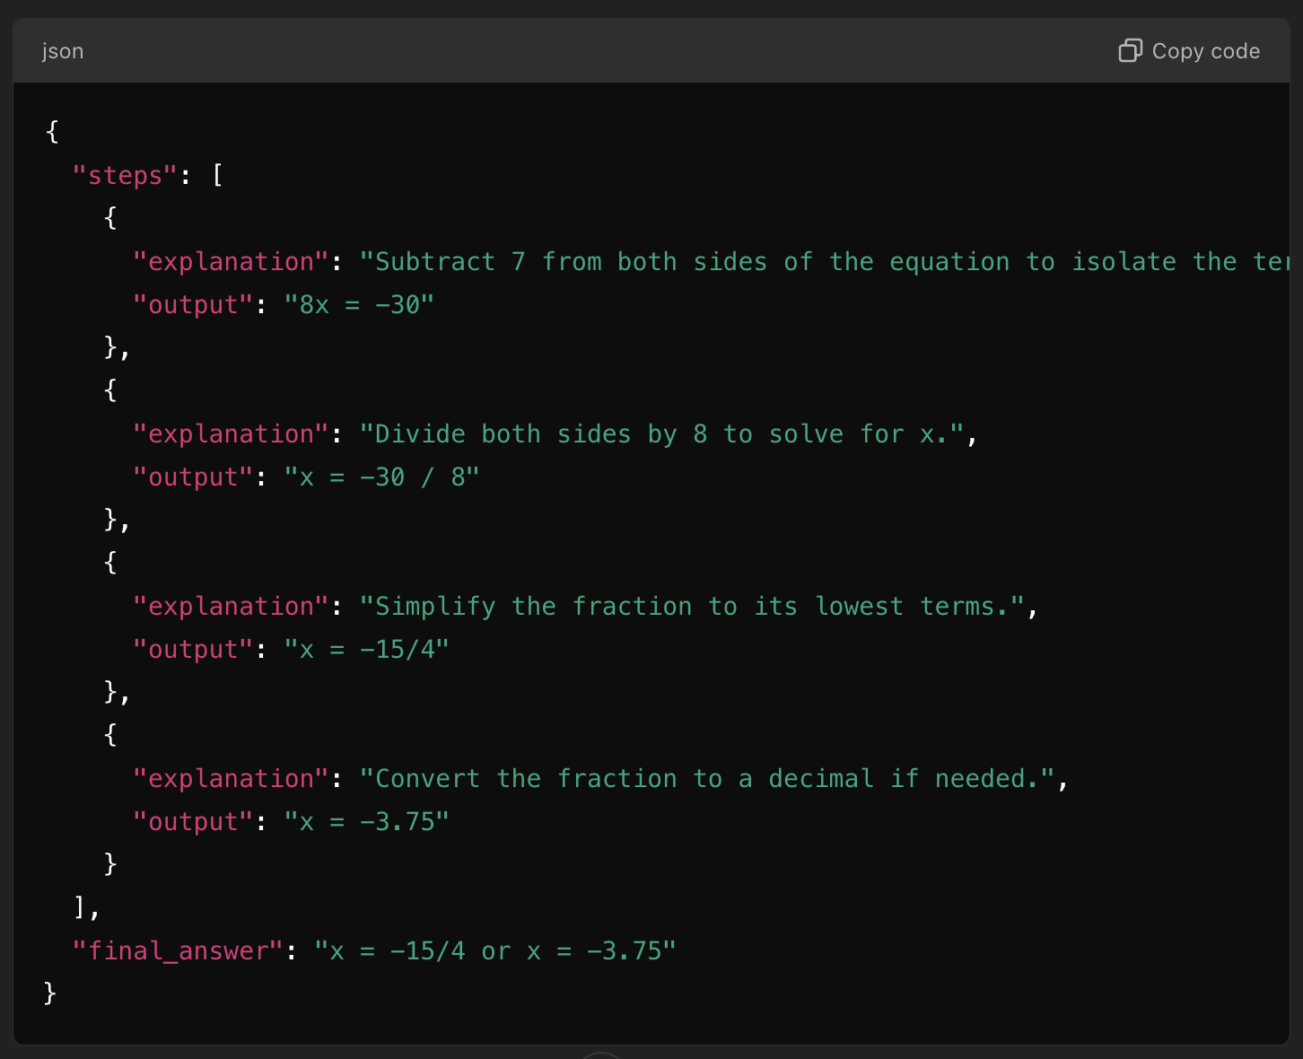

Slide 27
DEMO

